Slide 2
Lesson 3: Object Oriented Design (10hrs)
Writing contracts: Describing and Elaborating Use Cases
Collaboration Diagram and Sequence Diagram
Objects and Patterns (information expert, creator, low coupling, high cohesion, controller)
Determining Visibility
Class Diagram

Slide 3
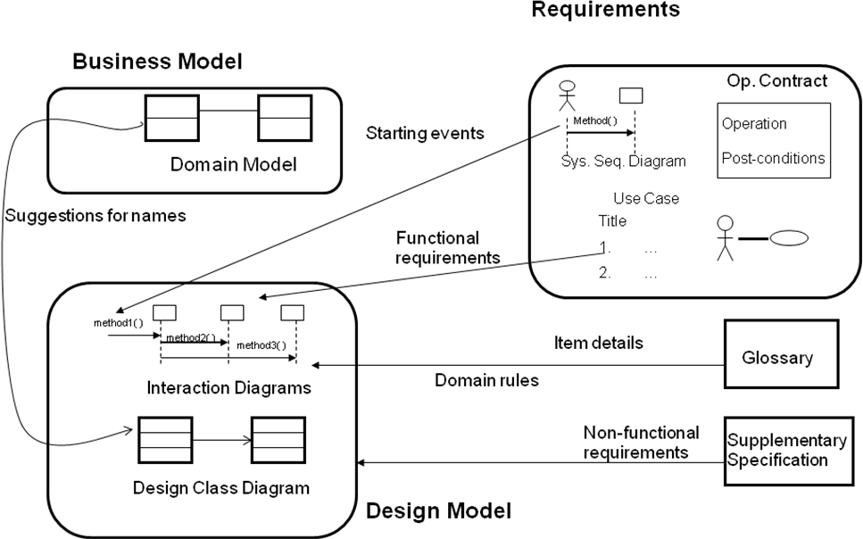
OOD

Slide 4
Object Oriented Design Outputs
INTERACTION DIAGRAM
Serves as Extension of System Sequence Diagram
Add specific objects to the System Sequence Diagram to handle system events.
Sequence diagrams depict parallel vertical lines representing processes or objects and horizontal arrows indicating the order of exchanged messages.
There are two common types:
Collaboration/Communication diagrams
Sequence diagrams

Slide 5
Communication/Collaboration Diagram
Collaboration diagrams (also called Communication diagrams) show a particular sequence of messages exchanged between several objects.
Sequence diagram highlight more the temporal aspect of the system i.e. it shows object interaction in timely manner (No Need of numbering the messages).
In Collaboration diagram, the temporal aspect are represented by numbering the interactions with sequential labels. (Need of numbering the messages).
So, Sequence numbers are used to show the time ordering among the messages.

Slide 6
Communication/Collaboration Diagram
message1()
:ClassAInstance
2.1:message2()
2.2:message3()
:ClassBInstance

Slide 7
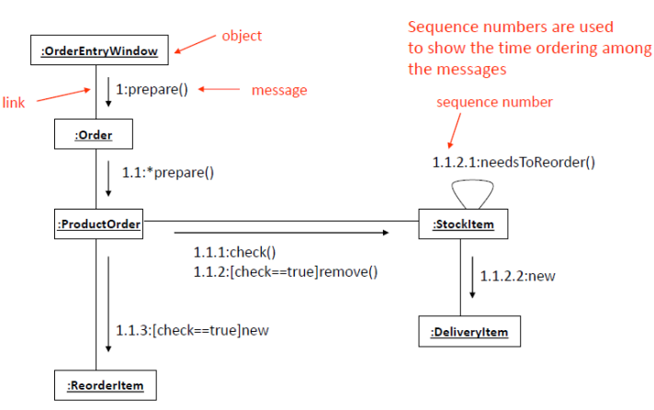
Communication/Collaboration Diagram

Slide 8
Communication/Collaboration Diagram
A collaboration diagram shows both structural and behavioral aspects explicitly.
This is unlike a sequence diagram which shows only the behavioral aspects.
The structural aspect of a collaboration diagram consists of objects and the links existing between them.
The behavioral aspect is described by the set of messages exchanged among the different collaborators or objects.
The link between objects is shown as a solid line and can be used to send messages between two objects.
The message is shown as a labeled arrow placed near the link.
Messages are prefixed with sequence numbers because they are only way to describe the relative sequencing of the messages in this diagram.

Slide 9
Notations: Classes and Instances
The UML has adopted a simple and consistent approach to illustrate instances vs. classifiers ).
For any kind of UML element (class, actor, ...), an instance uses the same graphic symbol as the type, but the designator string is underlined.
Class Instance Named Instance
Sale
:Sale
S1: Sale

Slide 10
Notations: Links
A link is a connection path between two objects.
It indicates some form of navigation and visibility between the objects.
1:makePayment(cash)
:Register
2:check()
:Sale
2.1:authenticate()
Link Line

Slide 11
Notations: Messages
Each message between objects is represented with a message expression and small arrow indicating the direction of the message.
Many messages may flow along this link .
A sequence number is added to show the sequential order of messages.
start()
1:makePayment(cash)
:Register
2:check()
:Sale
2.1:authenticate()
All messages flow on same link

Slide 12
Notations: Messages to “self” or “this”
A message can be sent from an object to itself.
This is illustrated by a link to itself, with messages flowing along the link.
start()
1:makePayment(cash)
:Register
2:check()
:Sale
2.1:authenticate()
3:clear()
Message to self

Slide 13
Message Number Sequencing
The order of messages is illustrated with sequence numbers
1. The first message is not numbered. Thus, start() is unnumbered.
2. The order and nesting of subsequent messages is shown with a legal numbering scheme in which nested messages have a number appended to them.
Nesting is denoted by prepending the incoming message number to the outgoing message number.
makePayment(cash)
:Register
2:check()
:Sale
2.1:authenticate()
First message is not numbered

Slide 14
Conditional Messages
A conditional message is shown by following a sequence number with a conditional clause in square brackets, like an iteration clause.
The message is only sent if the clause evaluates to true.
1 [login=‘admin’]: purchase
:Register
:Sale
Square brackets

Slide 15
Mutually Exclusive Conditional Paths
msg1()
:ClassA
1a [test1]: msg2()
:ClassB
1b [not test1]: msg4()
1a.1: msg3()
:ClassD
1b.1: msg5()
:ClassC

Slide 16
Iteration or Looping
Iteration notation is shown in Figure below.
If the details of the iteration clause are not important to the modeler, a simple ‘*’ can be used.
1*[i:=1…n] : integer : run()
:Game
:Simulator
2*: msg2()

Slide 17
Return Type
A return value may be shown by preceding the message with a return value variable name and an assignment operator (:=).
The type of the return value may be optionally shown.
In the fig integer is the return value for the function run().
1*[i=1..n]: integer:= total()
:Sale
:SaleLineItem
2*: msg2()

Slide 18
Hotel Reservation
Draw Collaboration Diagram for a hotel reservation scenario.
The Reservation window sends a makeReservation() message to a HotelChain.
The HotelChain then sends a makeReservation() message to a Hotel.
If the Hotel has available rooms, then it makes a Reservation and a Confirmation.

Slide 19
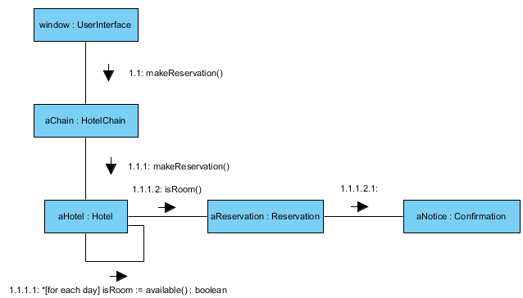
Hotel Reservation

Slide 20
Create a Collaboration Diagram for the ATM system.
User enters withdraw operation.
TM asks for the amount.
User enters the amount.
ATM sends amount value to Bank.
Bank checks for balance.
ATM dispenses the cash.
The balance of the User’s account is updated after the successful transaction completion.
User asks for the receipt to the ATM system.
ATM system gives the receipt to the user.

Slide 21
Create a Collaboration Diagram for the ATM system.
Objects involved:
ATM
USER
BANK

Slide 22
Create a Collaboration Diagram for the ATM system.
1 Select(withdraw)
4 SendAmount
2 getAmount()
5 Check Balance
user : User
3 EnterAmount
atm : ATM
bank : Bank
7 UpdateBalance()
6 dispenseCash(Amount)
8 getReceipt()
9 return Receipt

Slide 24
PREVIEW FOR LECTURE 10
SEQUENCE DIAGRAMS

